Slide 1
TRANSFORM VARIABLES

Slide 2
OVERVIEW
In a variable’s initial (“Raw”) state, it might not be suitable for use in a predictive model. When this occurs, a variable might need to be transformed
The two most likely situations where numeric data needs to be transformed are:
Missing Data
Outliers
The two most likely situations where categorical or “Class” data needs to be transformed are:
Missing Data
Converting categories to flag variables
Missing data transformation is covered separately

Slide 3
Useful Functions

Slide 4
Useful Functions
ABSOLUTE VALUE: (Positive Value of a number)
SAS SYNTAX: Y=abs(X);
Useful when a mathematical operation requires only positive values
X | abs(X)
10 | 10
1 | 1
0 | 0
-1 | 1
-10 | 10

Slide 5
Useful Functions
SIGN VALUE: Determines if a value is positive, negative, or zero
SAS SYNTAX: Y=sign(X);
Returns a +1, 0, -1 depending upon if a value is positive, zero, or negative.
Usually applied with ABS function to return a value back to its original sign after an operation is complete.
X | sign(X)
10 | 1
1 | 1
0 | 0
-1 | -1
-10 | -1

Slide 6
Useful Functions
LOGARITHM: “What exponent will return this value?”
Base can be any positive value, but usually it is 10 or “e”
“e” is the natural exponent is approximately 2.71828
Notation:
LOG10: Logarithm Base 10 (sometimes “LOG”)
LOG: Logarithm Base “e” (sometimes “LN” … also called natural log)
Logarithms require that X > 0
Example:
LOG10(100) = 2 because 10²=100
LOG(100) = 4.6052 because e^{4.6052}=100
Logarithms are used when data sets have outlier values that need to be constrained.

Slide 7
Useful Functions
LOGARITHMS of “X”:
SAS SYNTAX for LOG10 : Y=LOG10(X);
SAS SYNTAX for LN : Y=LOG(X);
X | ln(x) | log(x) |  | e^{(ln(x))} | 10^{(log(x))}
0.1 | -2.3026 | -1 |  | 0.1 | 0.1
1 | 0 | 0 |  | 1 | 1
2.7183 | 1 | 0.4343 |  | 2.7183 | 2.7183
5 | 1.6094 | 0.6990 |  | 5 | 5
10 | 2.3026 | 1 |  | 10 | 5
50 | 3.9120 | 1.6990 |  | 50 | 50
100 | 4.6052 | 2 |  | 100 | 100

Slide 8
Create Data Set
The following SAS code will create a data that will be used for this analysis. The DATA STEP code will generate a SAS Data Set called “TEMPFILE” that will contain two random variables:
X is a numeric variable
COLOR is a categorical variable

Slide 9
Create Data Set
%let HOWMANY = 10000;
%let SEED = 1;
data TEMPFILE;
call streaminit(&SEED.);
do i = 1 to &HOWMANY.;
X = 10*rand("normal") + 10*rand("lognormal") - 10*rand("uniform");
X = sign(X)*abs(X)**(1.5);
length COLOR $6;
COLOR = "???";
if X < -100 then COLOR = "RED";
else if X < 0 then COLOR = "ORANGE";
else if X < 100 then COLOR = "YELLOW";
else if X < 500 then COLOR = "GREEN";
else if X < 1000 then COLOR = "BLUE";
else COLOR = "VIOLET";
output;
end;
drop i;
run;

Slide 10
Examine the Data
Prior to transforming the data, it needs to be explored to determine what type of transformations might be appropriate.
Note that in SAS, there are many different ways to accomplish the exploration tasks. The methods presented here are not necessarily the best methods. These techniques are more of a reflection of the habits and preferences of the author.
Feel free to use different techniques in SAS or other languages.

Slide 11
Examine the Data
PROC CONTENTS displays the number of records in the file, the number of variables in the file, and names and types of each varible.
PROC PRINT displays the first 10 observations in the file (change obs=10) to a larger or smaller number if desired.
PROC MEANS gives the number of observations, the mean, standard deviation, min, max of the X variable.
PROC UNIVARIATE gives a histogram of the X variable (it can also give similar information as PROC MEANS, but the author prefers the abbreviated output of PROC MEANS)
PROC FREQ gives the distribution and histogram of the COLOR variable.

Slide 12
Examine the Data
proc contents data=TEMPFILE;
run;
proc print data=TEMPFILE(obs=10);
run;
proc means data=TEMPFILE n mean stddev min max;
run;
proc univariate data=TEMPFILE noprint;
histogram X;
run;
proc freq data=TEMPFILE;
table COLOR / plots=freqplot;
run;

Slide 13
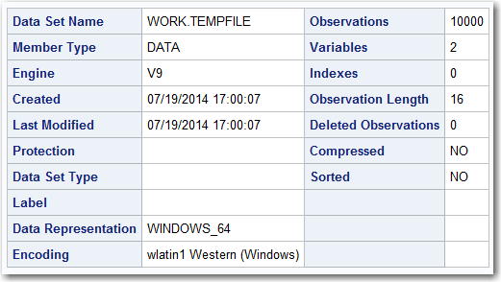
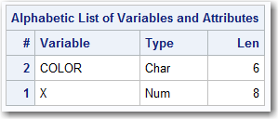
Examine the Data
proc contents data=TEMPFILE;
run;
There are 1000 records and two variables. X is a numeric variable and COLOR is a character (categorical) variable.

Slide 14
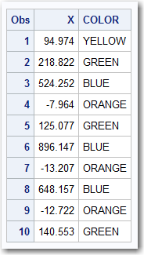
Examine the Data
proc print data=TEMPFILE(obs=10);
run;
The first 10 records are displayed. In order to display more records or fewer records, then alter the “obs=10” to reflect the desired number or records.

Slide 15
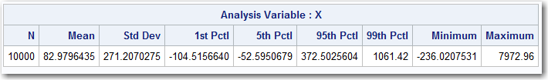
Examine the Data
proc means data=TEMPFILE n mean stddev p1 p5 p95 p99 min max;
var X;
run;
proc univariate data=TEMPFILE noprint;
histogram X;
run;
PROC MEANS output is given below
n: The number of records
mean: The average of X
stddev: The Standard Deviation of X
p1,p5,p95,p99: Value of X at a given percentile
min / max: The minimum / maximum value of X
PROC UNIVARIATE output is given in the following slide. It shows that the data has large outliers. Outlier variables can adversely affect some analytic techniques, so they need to be transformed.

Slide 16
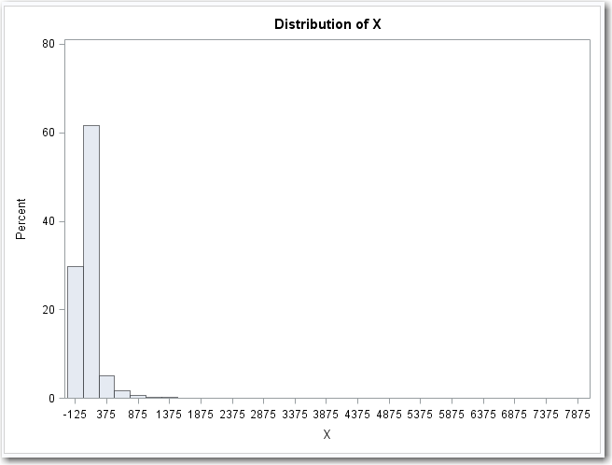
Examine the Data

Slide 17
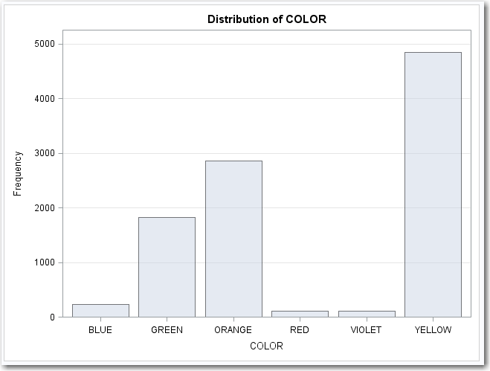
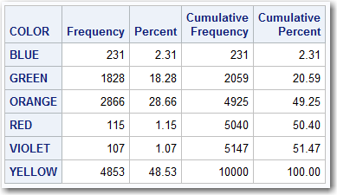
Examine the Data
proc freq data=TEMPFILE;
table COLOR / plots=freqplot;
run;
PROC FREQ output is given below. It shows 6 categories, three of which are well populated.

Slide 18
Numeric Transforms

Slide 19
Numeric Transforms
VARIABLE “X”
Referring to the bar chart from PROC UNIVARIATE (See following slide) it is obvious that “X” contains outliers.
It is possible that the outliers in “X” might exert undue influence on a predictive model, so it may be desirable to transform “X” to eliminate the outlier variables.
Some methods considered will be:
Trimming the Data
Standardizing the Data
Log Transform
Binning: (Quantile and Buckets)

Slide 20
Numeric Transforms

Slide 21
Numeric Transforms
Trimming Data

Slide 22
Transform: Trimming Data
When a variable exceeds a certain limit, it is simply truncated so that it cannot exceed the limit.
Example: Limit X to a range of -5 to +10
X | If X > 10 then X=10; else if X < -5 then X=-5;
-10 | -5
-5 | -5
-3 | -3
0 | 0
5 | 5
10 | 10
15 | 10

Slide 23
Transform: Trimming Data
Referring to the output of PROC MEANS (below) it is seen that:
95% of the data points are in the range of X < 373 (rounded)
99% of the data points are in the range of X < 1061 (rounded)
As opposed to manually hard coding the limits (which would be perfectly fine), the following code will:
Run a PROC MEANS and store the output into a SAS Data Set named “MEANFILE”
The variables inside of MEANFILE will be stored in Macro Variables (“call symput”)
The data will then be “Trimmed” using a SAS Data Step

Slide 24
Transform: Trimming Data
proc means data=TEMPFILE noprint;
output out = MEANFILE
P1(X) = P01x
P5(X) = P05x
P95(X) = P95x
P99(X) = P99x;
run;
proc print data=MEANFILE;
run;
data;
set MEANFILE;
call symput("P01x",P01x);
call symput("P05x",P05x);
call symput("P95x",P95x);
call symput("P99x",P99x);
run;
data XFORM;
set TEMPFILE;
T95_X = max(min(X,&P95x.),&P05x.);
T99_X = max(min(X,&P99x.),&P01x.);
run;

Slide 25
Transform: Trimming Data (BEFORE)

Slide 26
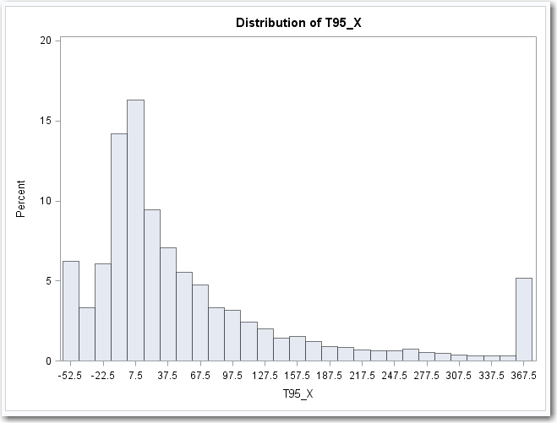
Transform: Trimming Data (95% LEVEL)

Slide 27
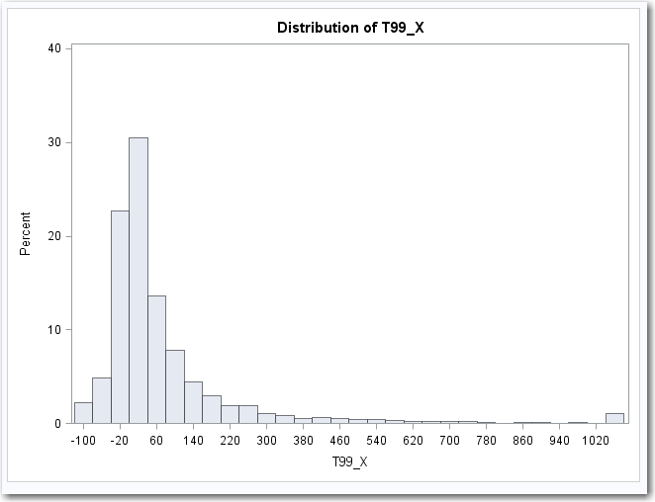
Transform: Trimming Data (99% LEVEL)

Slide 28
Numeric Transforms
Standardizing (Z-Transform)

Slide 29
Transform: Standardizing (Z-Transform)
Subtract the Mean and Divide by the Standard Deviation. Usually results in a value +/- 3 (unless there are some serious outliers)
Example: Assume that Mean=50 Standard Deviation=30
X | (X-50) / 30
-10 | -2
83 | 1.1
50 | 0
59 | 0.3
-1 | -1.7
146 | 3.2

Slide 30
Standardizing (Z-Transform)
Referring to the output of PROC MEANS (below) it is seen that:
Mean is 83 (rounded)
Standard Deviation is 271 (rounded)
As opposed to manually hard coding the Mean and Standard Deviation, the following code will:
Run a PROC MEANS and store the output into a SAS Data Set named “MEANFILE”
The variables inside of MEANFILE will be stored in Macro Variables (“call symput”)
The data will then be “Standardized” using a SAS Data Step
A second variable is also created that TRIMS the Standardized variable to +/-3

Slide 31
Standardizing (Z-Transform)
proc means data=TEMPFILE noprint;
output out = MEANFILE
mean(X) = U
stddev(X) = S;
run;
proc print data=MEANFILE;
run;
data;
set MEANFILE;
call symput("U",U);
call symput("S",S);
run;
data XFORM;
set TEMPFILE;
STD_X = (X-&U.)/&S.;
T_STD_X = max(min(STD_X,3),-3);
run;

Slide 32
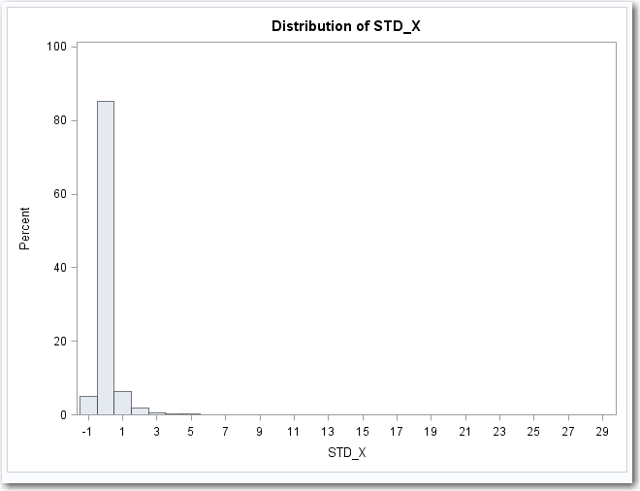
Standardizing (Z-Transform)

Slide 33
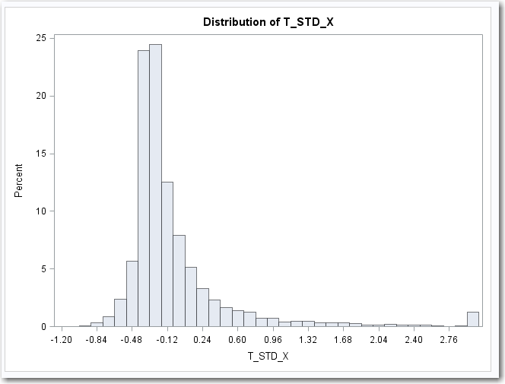
Standardizing (Z-Transform) Trimmed to +/- 3

Slide 34
Numeric Transforms
Log Transform

Slide 35
Transform: Log Transform
Logarithms require X > 0, so this transform will do the following:
Take the Absolute Value of X and Add 1
Perform Log Function (Log10, LN, or any Log of any other Base)
Multiply by the original Sign of “X”
X | Sign(X)*ln(abs(x)+1) | Sign(X)*log₁₀(abs(x)+1)
0 | 0 | 0
.1 | 0.10 | 0.04
-.1 | - 0.10 | - 0.04
1 | 0.69 | 0.30
-1 | - 0.69 | - 0.30
10 | 2.40 | 1.04
-10 | - 2.40 | - 1.04

Slide 36
Transform: Log Transform
Properties of this transformation:
Log Transform (0) = 0
Log Transform (-X) = -1*Log Transform(X)
A higher logarithm base will give a more tightly grouped set of data points.
The following code with perform the LOG TRANSFORM for:
Natural Log (LN) which is LOG Base 2.71828
Log Base 10
data XFORM;
set TEMPFILE;
LN_X = sign(X) * log(abs(X)+1);
LOG10_X = sign(X) * log10(abs(X)+1);
run;

Slide 37
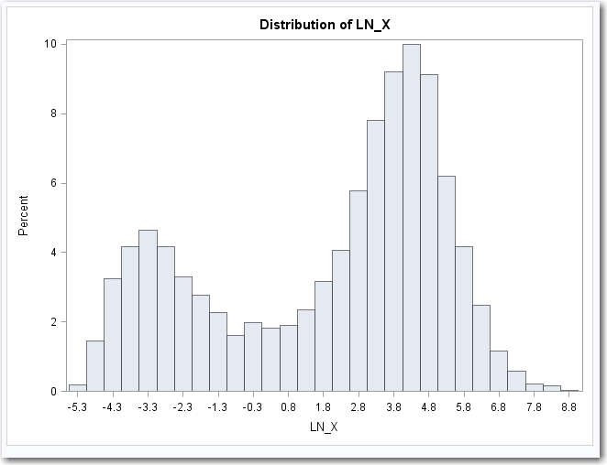
Transform: Log Transform (Base 2.71828)

Slide 38
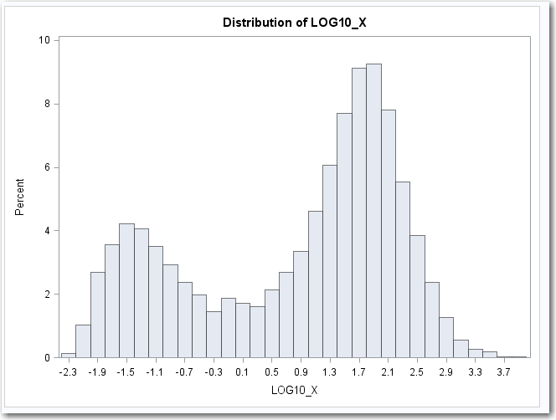
Transform: Log Transform (Base 10)

Slide 39
Numeric Transforms
Binning

Slide 40
Transform: Binning
Binning is the process of placing the X values into a predefined number of groups. The grouping can be done in any way desired. Some common approaches include:
BUCKETS: The bins are equally spaced, membership in each bin might not be equal
QUANTILES: Grouping done so that nearly equal membership in each bin
AD HOC: Grouping done based on a business rule or some other reasoning
EXAMPLE: Assume that 12 students took a placement exam which had scores from 0 to 100. Here are 3 possible way of binning the scores into 4 distinct buckets
BUCKETS: 4 equally spaced bins: 0-25, 26-50, 51-75, 76-100
QUANTILES: 4 bins with 3 members in each group: 0-45,46-73,74-90,91-100
AD HOC: 4 bins based on business rules: 0-69, 70-79, 80-89, 90-100

Slide 41
Transform: Binning
X | BUCKET | QUANTILE | AD HOC
20 | 0 | 0 | 0
40 | 1 | 0 | 0
45 | 1 | 0 | 0
60 | 2 | 1 | 0
70 | 2 | 1 | 1
73 | 2 | 1 | 1
80 | 3 | 2 | 2
85 | 3 | 2 | 2
90 | 3 | 2 | 3
93 | 3 | 3 | 3
95 | 3 | 3 | 3
99 | 3 | 3 | 3

Slide 42
Numeric Transforms
Binning : Buckets

Slide 43
Transform: Binning (Buckets)
The following SAS code will place the X values into 4 equally space buckets.
Run a PROC MEANS and store the output into a SAS Data Set named “MEANFILE”
The variables inside of MEANFILE will be stored in Macro Variables (“call symput”)
The data will then do the following:
Using the MIN and MAX values from PROC MEANS, Normalize the X values to a range of 0.0 to 1.0
Multiply the normalized value by the number of desired buckets and take the integer value
The result will be an integer ranging from 0 to N-1 (where N is the number of buckets).
Example:
If there are 4 desired buckets and the normalized value is 0.7
4 * 0.7 = 2.8
Integer value of 2.8 = 2
BUCKET = 2

Slide 44
Transform: Binning (Buckets)
proc means data=TEMPFILE noprint;
output out = MEANFILE
min(X) = MINx
max(X) = MAXx;
run;
data;
set MEANFILE;
call symput("MINx",MINx);
call symput("MAXx",MAXx);
run;
%let BIN = 4;
data XFORM;
set TEMPFILE;
NORM_X = ( X - &MINX. ) / (&MAXX.-&MINX.);
BUCKET_X = min(int(&BIN.*NORM_X),&BIN.-1);
run;

Slide 45
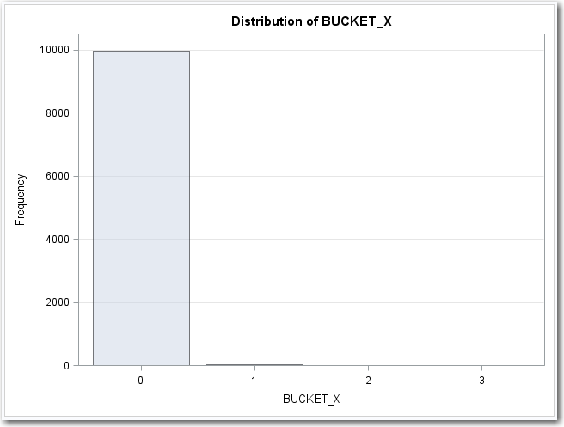
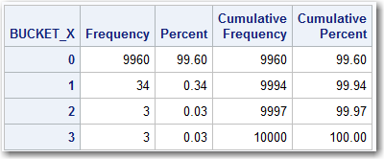
Transform: Binning (Buckets)
proc freq data=TEMPFILE;
table BUCKET_X / plots=freqplot;
run;
PROC FREQ output is given below. It shows 4 categories, Only one of which is well populated.

Slide 46
Numeric Transforms
Binning : Quantiles

Slide 47
Transform: Binning (Quantiles)
The following SAS code will place the X values into 4 quantiles that will all have approximately the same membership.
Run a PROC RANK and store the output into a SAS Data Set named “RANKFILE”
Run a PROC MEANS and determine the maximum value of each Quantile
Write a Data Step with “IF-THEN-ELSE” Logic to put X into a Quantile
NOTE: After the PROC RANK has been executed, the data has been placed into the appropriate quantiles. The data step is therefore unnecessary. The purpose of writing the DATA STEP is to be able to put new data into quantiles when the model has been placed into production.

Slide 48
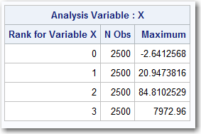
Transform: Binning (Quantiles) (Part 1)
%let BIN = 4;
proc rank data=TEMPFILE out=RANKFILE groups=&BIN.;
var X;
ranks QUANT_X;
run;
proc print data=RANKFILE(obs=10);
run;
proc means data=RANKFILE MAX;
class QUANT_X;
var X ;
run;

Slide 49
Transform: Binning (Quantiles) (Part 2)
data XFORM;
set TEMPFILE;
if X <= -2.6412568 then QUANT_X = 0;
else if X <= 20.9473816 then QUANT_X = 1;
else if X <= 84.8102529 then QUANT_X = 2;
else QUANT_X = 3;
run;

Slide 50
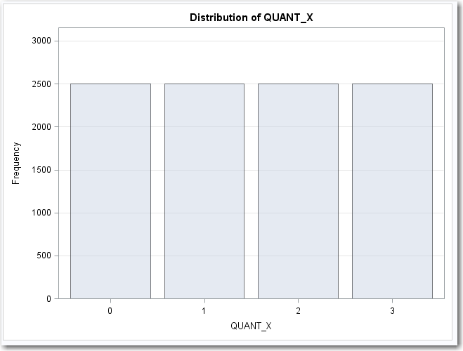
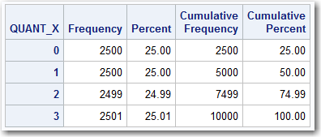
Transform: Binning (Quantiles)
proc freq data=TEMPFILE;
table QUANT_X / plots=freqplot;
run;
PROC FREQ output is given below. It shows 4 categories all of which are equally populated

Slide 51
Numeric Transforms
Binning : Ad Hoc

Slide 52
Transform: Binning (Ad Hoc)
Ad Hoc Binning is done based on a business rule or to achieve some business goal such as:
Bin variables related to customers based upon profitability
Bin variables to maximize predictive power
Bin variables based on any other decision
Bins are usually assigned with “IF-THEN-ELSE” Logic

Slide 53
Transform: Binning (Ad Hoc)
data XFORM;
set TEMPFILE;
if X <= 0 then ADHOC_X = 0;
else if X <= 100 then ADHOC_X = 1;
else if X <= 200 then ADHOC_X = 2;
else ADHOC_X = 3;
run;

Slide 54
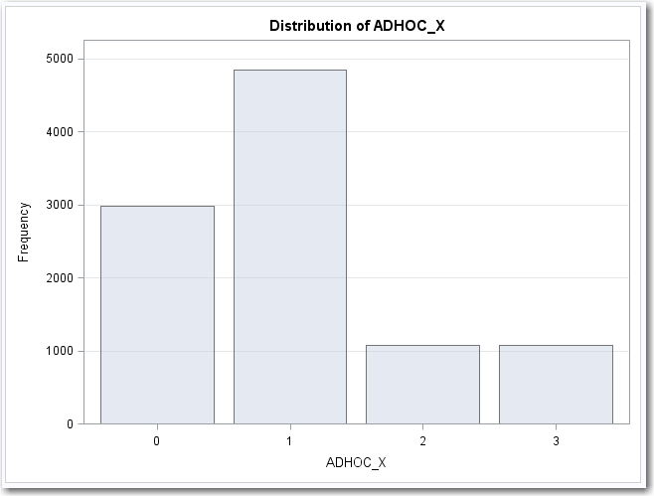
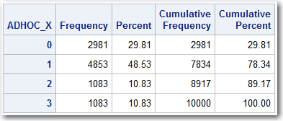
Transform: Binning (Ad Hoc)
proc freq data=TEMPFILE;
table ADHOC_X / plots=freqplot;
run;
PROC FREQ output is given below. It shows 4 categories, all of which are well populated.

Slide 55
Categorical Transforms

Slide 56
Categorical Transforms
Convert to Boolean (Flag) Variables

Slide 57
Transform: Flag Variables
Many times a category needs to be converted into a series of Flag variables for analytic purposes. Things to consider:
If desired, every category may have its own flag variable
If desired, some categories may be ignored (no flag)
If desired, several categories can be combined
Examples Marital Status of (Married, Single, Divorced, Widow, Unknown) might be grouped as
Married_YES = Marital_Status in (“Married”);
Married_NO = Marital_Status in (“Single”);
Married_OTHER = Marital_Status in (“Divorced”,”Widow”);
In the above example, Married and Single were kept as independent categories. Divorced and Widow were combined, and Unknown was ignored.

Slide 58
Transform: Flag Variables
proc freq data=TEMPFILE;
table COLOR / plots=freqplot;
run;
PROC FREQ output is given below. It shows 6 categories, three of which are well populated.

Slide 59
Transform: Flag Variables
Approach 1: Group RED/ORANGE, YELLOW/GREEN, and BLUE/VIOLET
data XFORM;
set TEMPFILE;
COLOR_RO = COLOR in ("RED","ORANGE");
COLOR_YG = COLOR in ("YELLOW","GREEN");
COLOR_BV = COLOR in ("BLUE","VIOLET");
run;
proc freq data=XFORM;
table COLOR_RO COLOR_YG COLOR_BV / plots=freqplot;
run;

Slide 60
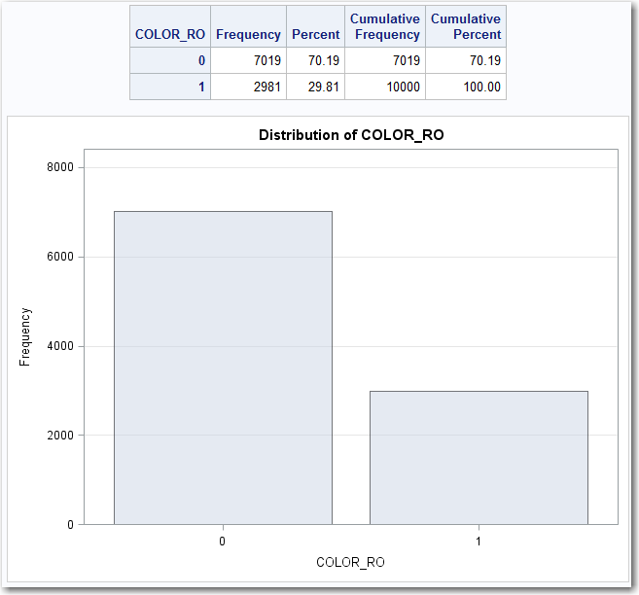
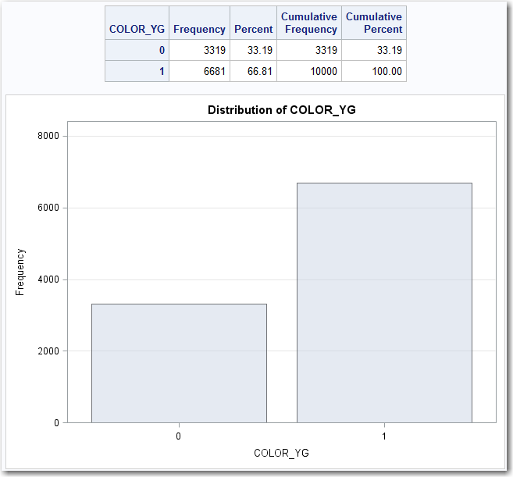
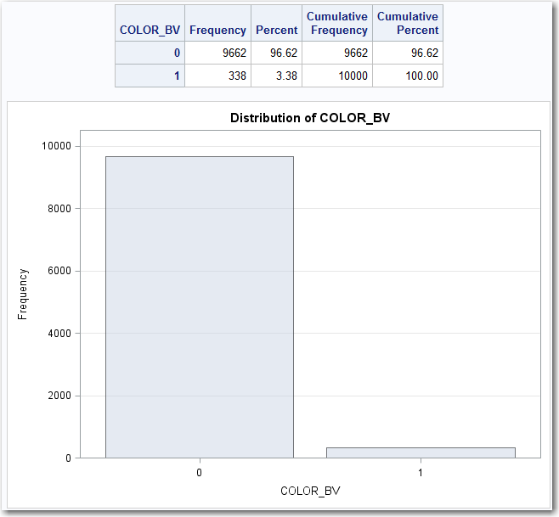
Transform: Flag Variables

Slide 61
Transform: Flag Variables
Approach 2: Put large categories into independent groups. Merge small categories into a single group
data XFORM;
set TEMPFILE;
COLOR_ORANGE = COLOR in ("ORANGE");
COLOR_YELLOW = COLOR in ("YELLOW");
COLOR_GREEN = COLOR in ("GREEN");
COLOR_OTHER = COLOR in ("RED","BLUE","VIOLET");
run;
proc freq data=XFORM;
table COLOR_ORANGE COLOR_YELLOW COLOR_GREEN COLOR_OTHER / plots=freqplot;
run;

Slide 62
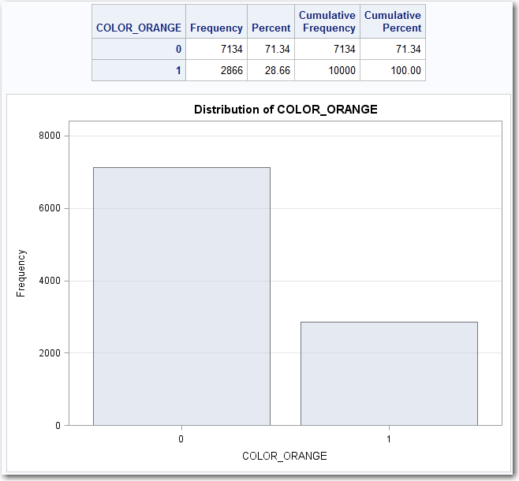
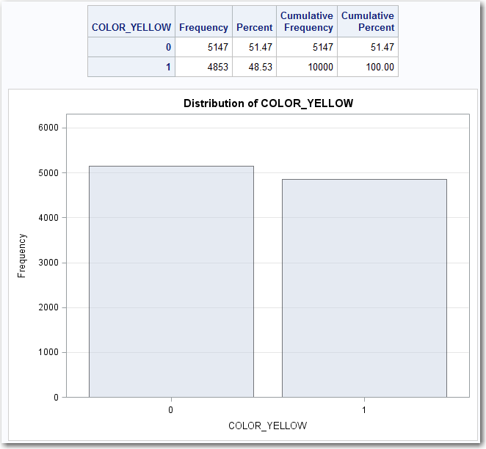
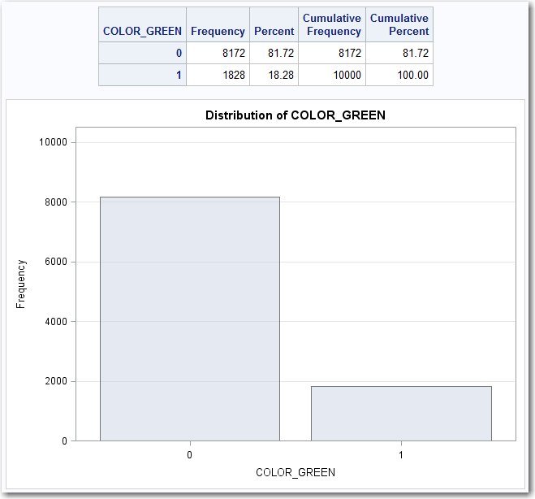
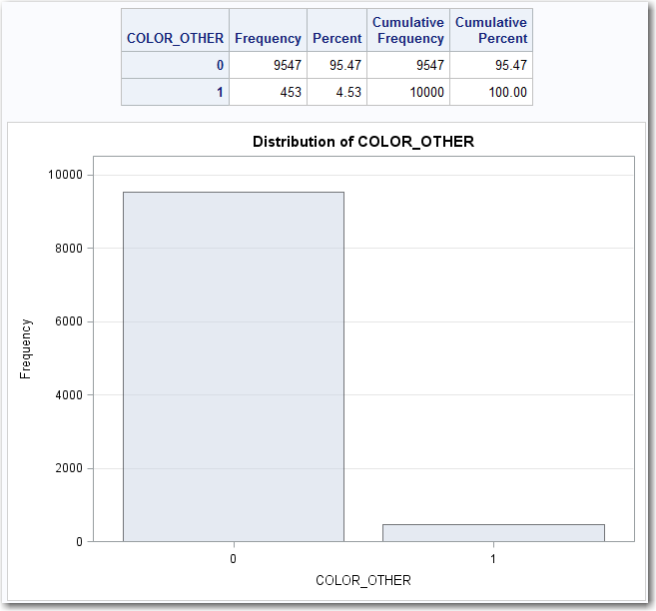
Transform: Flag Variables

